Slide 1

K-Means Clustering
Dr. Clif Baldwin

Slide 2

Euclidean Distance
The distance between 2 points (x₁,y₁) and (x₂,y₂) in a Euclidean space
distance = $\sqrt{{\left(x_{2}−x_{1}\right)}^{2}+{\left(y_{2}−y_{1}\right)}^{2}}$
i.e. the Pythagorean formula

Slide 3
K-Nearest Neighbors (kNN)*
The k-nearest neighbors algorithm is a non-parametric method used for classification
Given a dataset for which class labels are known, you want to predict the class of a new data point.
Compare the new observation to those observations already labeled.
The predicted class will be based on the known classes of the nearest k neighbors.
Algorithm
1. Calculate the Euclidean Distance (or whatever distance measurement you want) between the test data and the training data.
2. For each test data observation, arrange the calculated Euclidean distances in non-decreasing order.
3. Take the first k distances from this sorted list as the neighbors.
4. Determine the dominant response within the neighbors as the prediction for the test data observation.
*See chapter 3.5 of James, Witten, Hastie, and Tibshirani, 2013, An Introduction to Statistical Learning

Slide 4
K-Nearest Neighbors (kNN)
Credit ratings — collecting financial characteristics vs. comparing people with similar financial features to a database. By the very nature of a credit rating, people who have similar financial details would be given similar credit ratings.
Should the bank give a loan to an individual? Would an individual default on his or her loan? Is that person closer in characteristics to people who defaulted or did not default on their loans?
In political science — classing a potential voter to a “will vote” or “will not vote”, or to “vote Democrat” or “vote Republican”.
More advance examples could include handwriting detection (like OCR), image recognition and even video recognition.
Taken from
https://medium.com/@adi.bronshtein/a-quick-introduction-to-k-nearest-neighbors-algorithm-62214cea29c7

Slide 5
kNN Project (Example)
Algorithm
1. Calculate the Euclidean Distance (or whatever distance measurement you want) between the test data and the training data.
2. For each test data observation, arrange the calculated Euclidean distances in non-decreasing order.
3. Take the first k distances from this sorted list as the neighbors.
4. Determine the dominant response within the neighbors as the prediction for the test data observation.
Sample Assignment:
Write a K-Nearest Neighbors algorithm using Euclidean distances from scratch, which
saves or prints the predicted values for the test dataset,
computes and prints the accuracy statistic,
and displays a graph of the data.
Document each step of the code to demonstrate you understand what each line of code does.
Compare your algorithm’s output to the algorithm in R using knn().

Slide 6
K-Means Clustering
Used to find groups which have not been explicitly labeled in the data
Identifies possible patterns
May determine grouping of customers related to a product under consideration
May determine how documents could be grouped
See http://dni-institute.in/blogs/k-means-clustering-examples-and-practical-applications/ for more examples

Slide 7
K-Means vs KNN
K-Means creates groupings of similar data points dependent on the number of clusters
Unsupervised
KNN measures which point belongs to what classification by a distance calculation
Supervised
K-Means determines possible groups and KNN assigns data points to groups

Slide 8
K-Means Clustering
k-means creates k groups from a set of objects so that the members of a group are more similar
Unsupervised method designed to form similar groups
k-means picks points in multi-dimensional space to represent each of the k clusters. These are called centroids.
Weakness due to selection of k and initial centers

Slide 9
K-Means
Every point will be closest to 1 of the k centroids
Find the center for each of the k clusters based on its cluster members
This center becomes the new centroid for the cluster
Repeat until the centroids no longer change, and the cluster memberships stabilize
Convergence

Slide 10
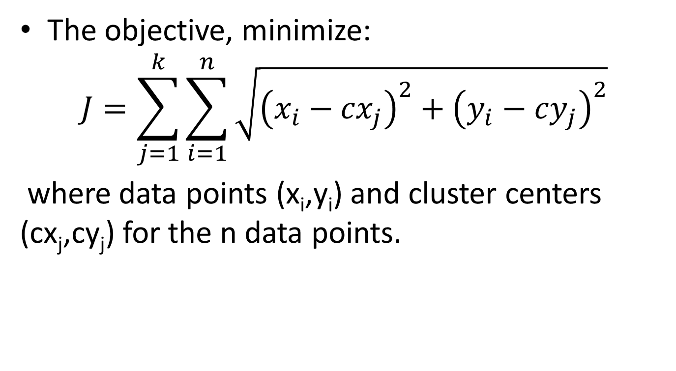
K-Means Clustering
The objective, minimize:
$$J=\sum_{j=1}^{k}{\sum_{i=1}^{n}{\sqrt{{\left(x_{i}−{cx}_{j}\right)}^{2}+{\left(y_{i}−{cy}_{j}\right)}^{2}}}}$$
where data points (x_{i},y_{i}) and cluster centers (cx_{j},cy_{j}) for the n data points.
Looks very similar to the Euclidean Distance formula!

Slide 11
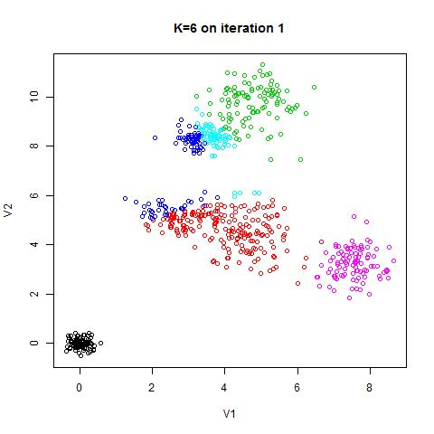
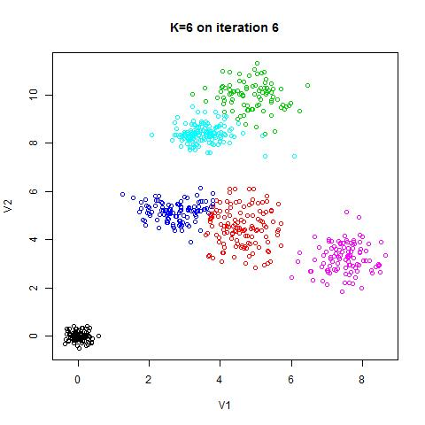
Initial selection of 6 random centers
After convergence

Slide 12
K-Means Clustering - pseudocode
Create k points for starting centroids
While any point has changed cluster assignment
For every point in our dataset:
For every centroid:
Calculate the distance between the centroid and point
Assign the point to the cluster with the lowest distance
For every cluster calculate the mean of the points in that cluster
Assign the centroid to the mean
See page 462 of The Elements of Statistical Learning, 2nd ed. (Hastie, Tibshirani, Friedman) January 2017 printing

Slide 13
Readings
Chapter 7, K-Means Clustering, pp. 257-265 of Bruce and Bruce, Practical Statistics
Chapter 10.3 of James, Witten, Hastie, and Tibshirani, 2013, An Introduction to Statistical Learning, specifically kmeans() in R (10.5.1 lab)
Example using K Nearest Neighbors https://medium.com/learning-machine-learning/recommending-animes-using-nearest-neighbors-61320a1a5934
Refer to “Machine Learning Workflows in Python from Scratch Part 2: k-means Clustering” http://www.kdnuggets.com/2017/06/machine-learning-workflows-python-scratch-part-2.html

Slide 14
Assignment 1
Write R code from scratch for a K-Means Clustering algorithm using Euclidean distances, which prints the total within-cluster sum of squares and displays a graph using the Elbow Method to determine an appropriate K.
Document each step of the code to demonstrate you understand what each line of code does. The code has to describe the steps in creating the model and steps in computing the sum of square errors. For your algorithm, you may use basic statistical functions and graphing functions but NOT machine learning functions such as kmeans().
Compare your algorithm’s output of clusters to the algorithms in R using kmeans(). Feel free to experiment with alternative measurements but at least one method must employ Euclidean distances.

Slide 15
Questions

Slide 16
K-Means Clustering (week 2)
Dr. Clif Baldwin

Slide 17
K-Means Clustering
Used to find groups which have not been explicitly labeled in the data
Identifies possible patterns
Unsupervised learning

Slide 18
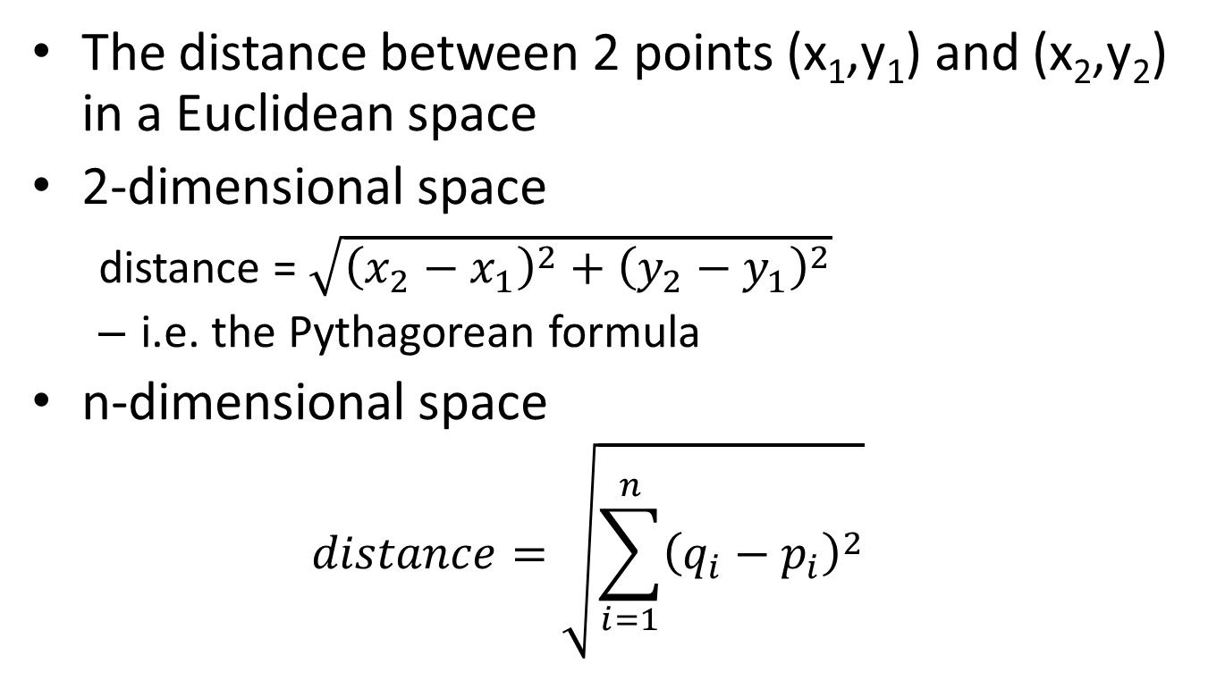
Euclidean Distance
The distance between 2 points (x₁,y₁) and (x₂,y₂) in a Euclidean space
2-dimensional space
distance = $\sqrt{{\left(x_{2}−x_{1}\right)}^{2}+{\left(y_{2}−y_{1}\right)}^{2}}$
i.e. the Pythagorean formula
n-dimensional space
$$distance=\sqrt{\sum_{i=1}^{n}{{\left(q_{i}−p_{i}\right)}^{2}}}$$

Slide 19
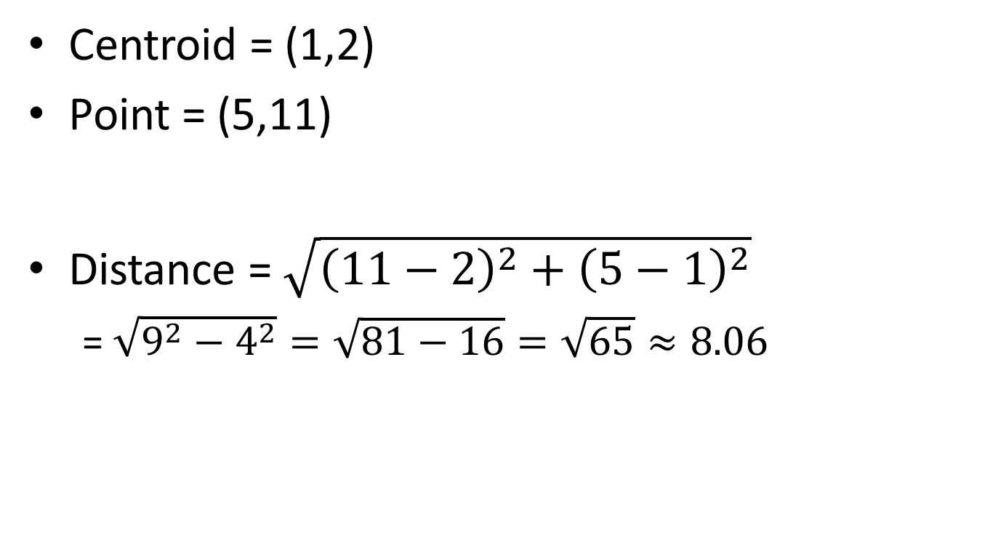
Example
Centroid = (1,2)
Point = (5,11)
Distance = $\sqrt{{\left(11−2\right)}^{2}+{\left(5−1\right)}^{2}}$
= $\sqrt{9^{2}−4^{2}}=\sqrt{81−16}=\sqrt{65}≈8.06$

Slide 20
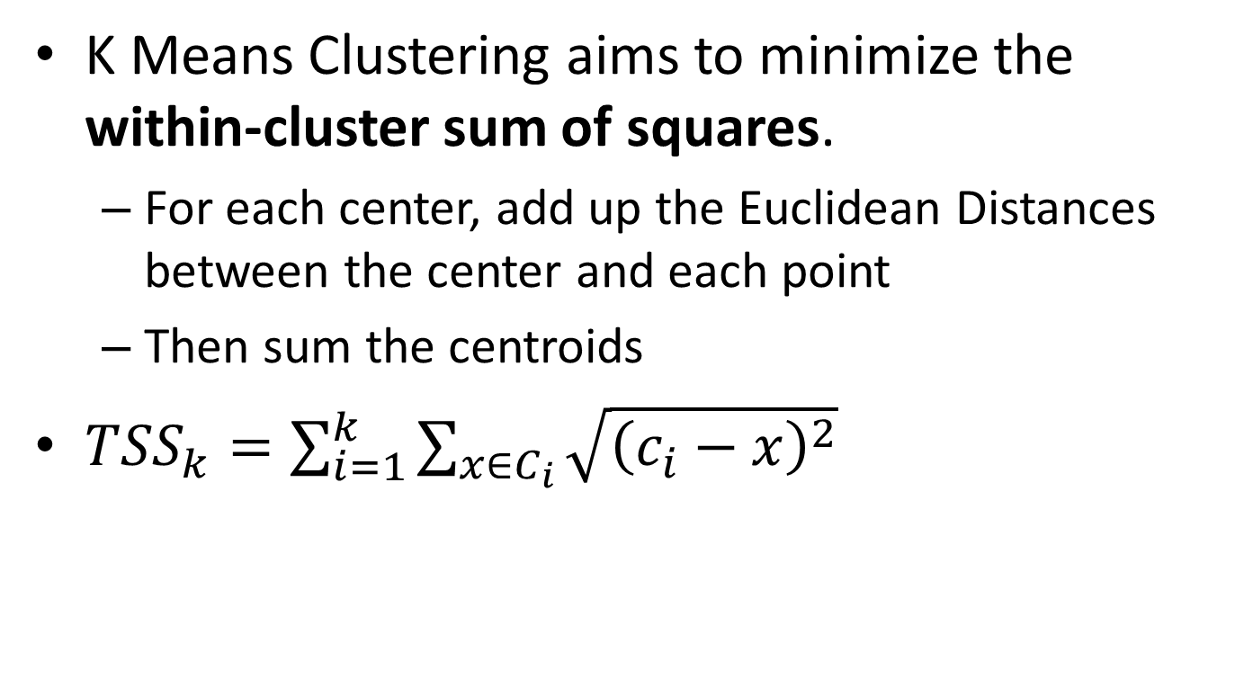
Objective
K Means Clustering aims to minimize the within-cluster sum of squares.
For each center, add up the Euclidean Distances between the center and each point
Then sum the centroids
${TSS}_{k}=\sum_{i=1}^{k}{\sum_{x∈C_{i}}{\sqrt{{\left(c_{i}−x\right)}^{2}}}}$

Slide 21
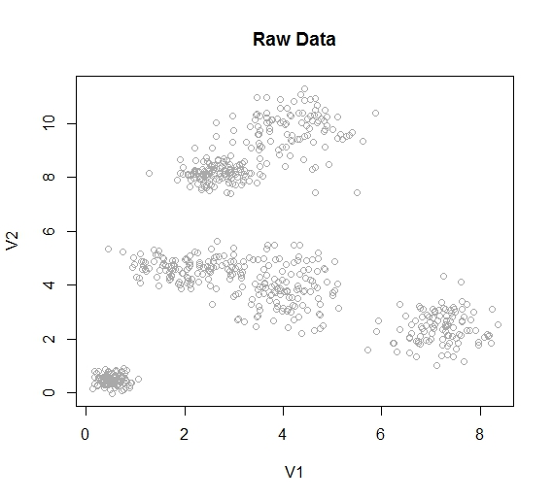

Slide 22
Sample : K-Means
Using my data and my code for the algorithm
K=2, TSS₂ = 1794.3
K=3, TSS₃ = 1282.6
K=4, TSS₄ = 681.2
K=5, TSS₅ = 540.8
K=6, TSS₆ = 522.7
K=7, TSS₇ = 534.1
K=8, TSS₈ = 504.1
K=9, TSS₉ = 366.6
K=10, TSS₁₀ = 350.6

Slide 23
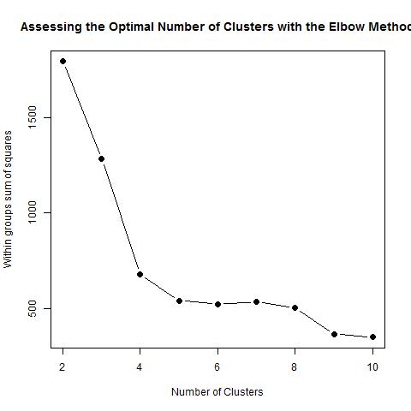
The Elbow Method

Slide 24
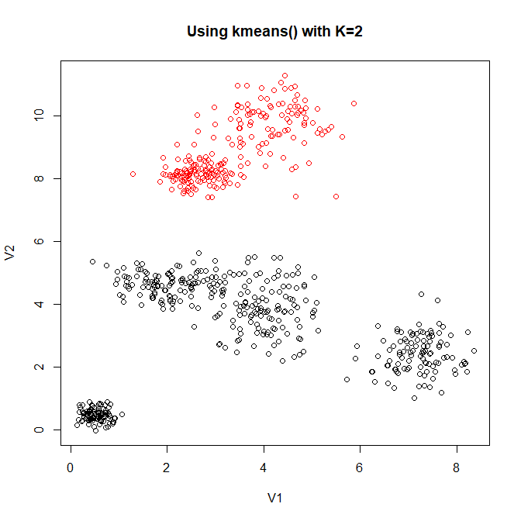

Slide 25
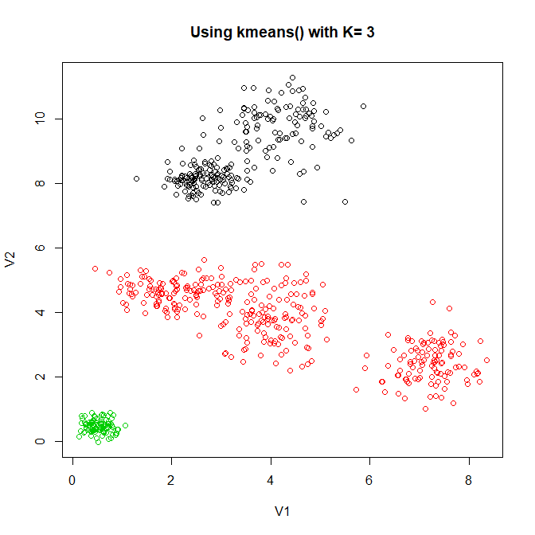

Slide 26
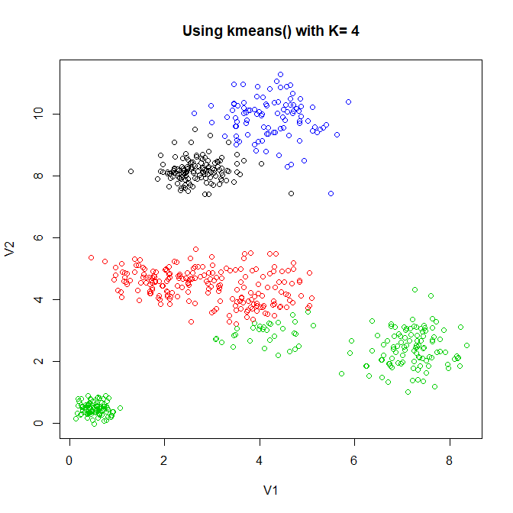

Slide 27
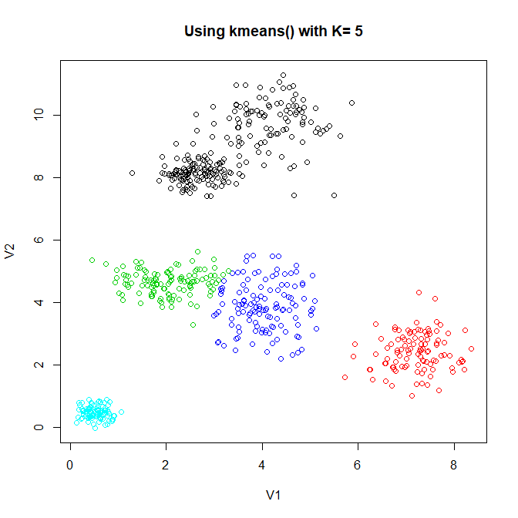

Slide 28
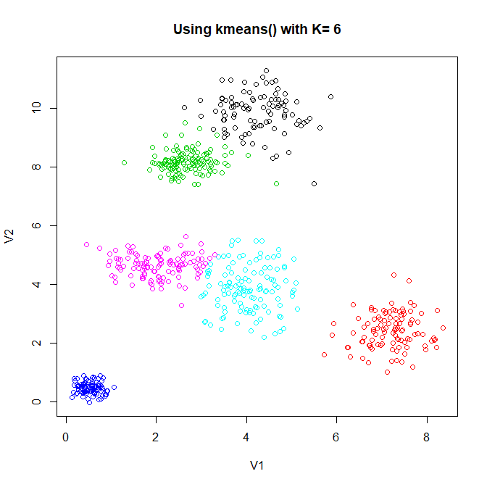
Iteration 3
= Actual Center

Slide 29
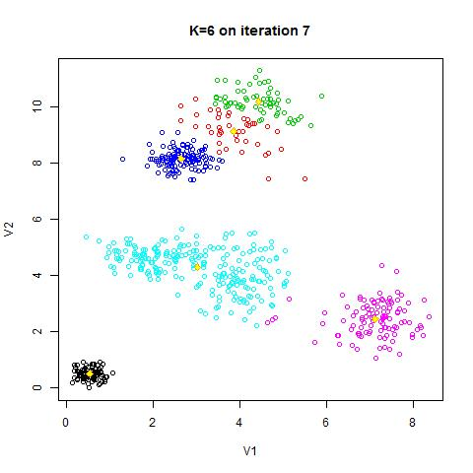
= Actual Center
Notes:
Remember, this is fabricated data. So I know the actual centers. In real life, the centers are not known and probably unknowable.

Slide 30
Readings
Chapter 7, Selecting the Number of Clusters, pp. 263-265 of Bruce and Bruce, Practical Statistics
See Algorithm 10.1 (p. 388) of James, Witten, Hastie, and Tibshirani, 2013, An Introduction to Statistical Learning

Slide 31
Questions

Slide 32
K-Means Clustering - pseudocode
Create k points for starting centroids
While any point has changed cluster assignment
For every point in our dataset:
For every centroid:
Calculate the distance between the centroid and point
Assign the point to the cluster with the lowest distance
For every cluster calculate the mean of the points in that cluster
Assign the centroid to the mean
Notes:
See page 462 of The Elements of Statistical Learning, 2nd ed. (Hastie, Tibshirani, Friedman) January 2017 printing

